Slide 2
God’s Promise for the week
“Whoever reveres his father will live a long life; he who obeys his father brings comfort to his mother.”
(Sir 3:6)
Notes:
2

Slide 3
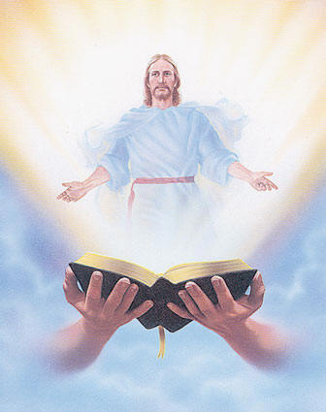
Welcome
Guest

Slide 4
ANNOUNCEMENTS
Dec. 29, 2017

Slide 5
First Friday Eucharistic Celebration
Jan. 5, 2018
Main Celebrant:
Fr. Dennis Kaelin

Slide 6
Marshaling
Schedule
Jan. 5, 2018
Mission
Apostolate

Slide 7
March for Life
Jan. 19, 2018
To sign up, please see members of the Singles Ministry or Mission during fellowship on a first come, first serve basis.

Slide 8
Medical Mission Announcement
Feb. 5-8, 2018
Tarlac City, Tarlac
Volunteers are requested to see the members of the Medical Mission core team during fellowship for some important information.

Slide 9
Save the Date
Apr. 7, 2018
Emergence

Slide 10
ORDER
“Wives, be subordinate to your husbands,... Husbands, love your wives,... Children, obey your parents in everything,...
Fathers (Parents), do not provoke your children,...”
(Col 3:18-21)

Slide 11
DIRECTIONS
● Invite more families to
join our Family Encounter.
● Participate in individual,
conjugal and family
prayers.

