Slide 1
ANNOUNCEMENTS
April 27, 2018

Slide 2
God’s Promise for the week
“If you remain in me and my words remain in you, ask for whatever you want and it
will be done for you.”
(John 15:7)
Notes:
2

Slide 3
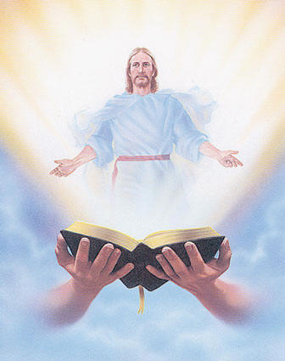
Welcome
Guest

Slide 4
MAY CROWNING
Procession of our
Lady of Fatima
by Mark 10 Ministry
May 4, 2018 after the 1st Friday mass at Divine Mercy Church
Notes:
The "May Crowning" is a traditional Roman Catholic ritual that occurs in the month of May. It is a devotion to the Blessed Virgin Mary honoring her as "the Queen of May".

Slide 5
TEACHINGS
Apologetics 2 – LSS 1-46
Gifts and Fruit of the Holy
Spirit - LSS 1- 48
Sienna Gifts Inventory - LSS 49
Sat., May 12, 2018, 1- 6 pm
@ DMP Classroom

Slide 6
What is God’s plan
in our married life?
Join the…
Marriage Encounter
Weekend #50
MAY 18-20, 2018
Hotel Executive Suite
30 Minue Street
Carteret, NJ 07008
Please email us at mla@bldnewark.com
BLD Newark

Slide 7
Marshaling
Schedule
May 4, 2018
Pastoral
Apostolate

Slide 8
ORDER
“Bear much fruit
and become my disciples.”
(John 15:8)

Slide 9
DIRECTIONS
● Love one another not in
word or speech, but in
deed and in truth.
● Meditate on the Word of
God regularly and do as
He tells you.

