Slide 1
God’s Promise for the week
“All who… hold to my covenant…I will bring to my holy mountains.”
Is 56:6b,7a
Notes:
1

Slide 2
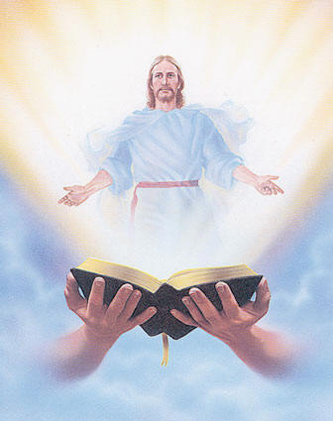
Welcome
Guest

Slide 3
ANNOUNCEMENTS
August 18, 2017

Slide 4
August 19, 2017
Community Celebration at the
Divine Mercy Parish
August 20, 2017
25th Anniversary Dinner Dance
Notes:
Please Read:
1) If you haven’t done so yet, but are planning to attend,
please send in your RSVP for the Community Celebration.
(2) Regarding the 25th Anniversary Dinner Dance on Aug 20, please turn in ticket remittances to the members of the sponsoring class, ME 40, as soon as possible.
They will have a table set up for this at fellowship.

Slide 5
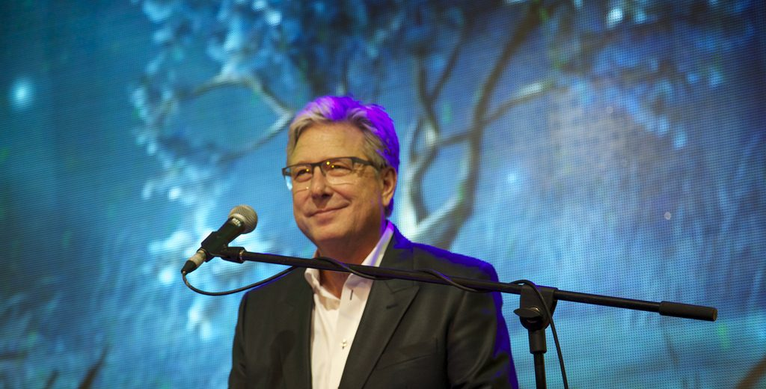
By HIS Grace…
We Worship
celebrating 25 years
Led by Don Moen
8:00 pm Saturday
August 19, 2017
(Doors Open at 7:00pm)
Union County Performing Arts Center
1601 Irving Street , Rahway NJ 07065

Slide 6
BLD Medical
Mission 2018
Venue:
Tarlac City, Tarlac
February 5 – 8, 2018
Contacts: Ramon & Leonie Mariazeta
Mon.Mariazeta@bldnewark.com
Notes:
Bukas Loob Sa Diyos (BLD) Newark 2018 Medical Mission
Details:
· Where: Tarlac City, Tarlac
· When: February 5 to 8, 2018 (Monday thru Thursday)
Medical Mission Coordinators: Ramon & Leonie Mariazeta
Web sign-up to follow.
Contact:
Email: Mon.Mariazeta@bldnewark.com
Phone: 732-382-6284

Slide 7
Reminder…
No Fellowship tonight,
See you all tomorrow!
Happy 25th Anniversary
BLD!!!

Slide 8
Marshaling
Schedule
AUG 25, 2017
Pastoral
Apostolate

Slide 9
ORDER
Observe what is right, do what is just;

Slide 10
DIRECTIONS
• Live according to the
commandments of God.
• Fulfill your commitment
& covenant pledges
faithfully.

