Slide 2
God’s Promise for the week
“The one who calls you is faithful, and he will also accomplish it.”
( 1Thes 5:24)
Notes:
2

Slide 3
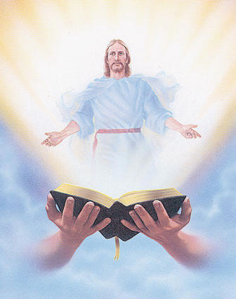
Welcome
Guest

Slide 4
ANNOUNCEMENTS
Dec. 15, 2017

Slide 5
FRIDAY, JANUARY 19, 2018
Notes:
Sign-ups begin this Friday, December 1
Please see the representatives from Mission and the Singles Ministry

Slide 6
Marshaling
Schedule
Dec. 22, 2017
Formation
Apostolate

Slide 7
ORDER
“Testify to the light, so that all might believe”
(Jn 1:7)

Slide 8
DIRECTIONS
● Pray unceasingly.
● Refrain from every
kind of evil.

