Slide 2
God’s Promise for the week
“He will keep you firm to the end, irreproachable
on the day of our
Lord Jesus Christ.”
(1Cor 1:8)
Notes:
2

Slide 3
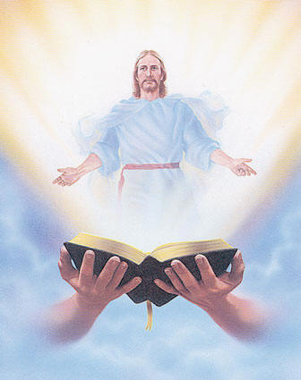
Welcome
Guest

Slide 4
ANNOUNCEMENTS
Dec. 1 2017

Slide 5
FRIDAY, JANUARY 19, 2018
Notes:
Sign-ups begin this Friday, December 1
Please see the representatives from Mission and the Singles Ministry

Slide 6
Marshaling
Schedule
Dec. 8, 2017
Pastoral
Apostolate

Slide 7
ORDER
“Be watchful! Be alert!”
(Mk 13:33a)

Slide 8
DIRECTION
Always seek the Holy Spirit who is our constant help and guide.

