Slide 2
God’s Promise for the week
“The Holy Spirit will come upon you…nothing will be impossible for God. ”
(Lk 1:35a,37)
Notes:
2

Slide 3
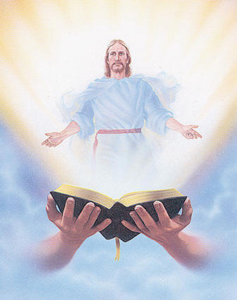
Welcome
Guest

Slide 4
ANNOUNCEMENTS
Dec. 22, 2017

Slide 5
Marshaling
Schedule
Dec. 29, 2017
Management
Apostolate

Slide 6
ORDER
"Do not be afraid,... for you have found favor with God.”
(Lk 1:30)

Slide 7
DIRECTIONS
● Imitate the obedience
of our Blessed Mother.
● Say “yes” to the call to
serve.

