Slide 2
God’s Promise for the week
“... keep the commandments, they will save you.”
(Sir 15:15)
Notes:
2

Slide 3
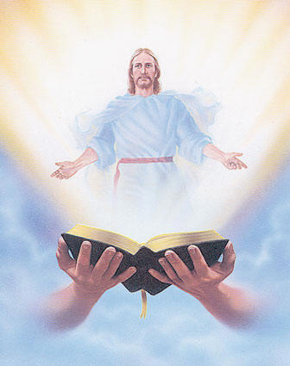
Welcome
Guest

Slide 4
ANNOUNCEMENTS
Feb. 10, 2017

Slide 5
TEACHINGS
Shepherd's Training - LSS 1- 45
Basic Bible Seminar - LSS 1- 46B
Christian Parenting - LSS 1-47
Sat., Feb. 18, 2017, 1- 6 pm
@ DMP Classrooms

Slide 6
Health & Wellness
Awareness day
Every first Friday at DMP
auditorium during fellowship.
Notes:
Free medical consultations, blood pressure and blood sugar screenings and health tips to be provided by volunteer medical professionals Every First Friday.
Begins on Friday, February 3, 2017

Slide 7
Life in the Spirit
Seminar #47
March 31-April 2, 2017
Salubungan / Acquaintance – Mar 3
Registration is Now Open
Contacts:
Manny & Nette Manguiat – elexman@hotmail.com,
Earl & Flo Manguiat - bldnewarklsa@gmail.com

Slide 8
Marshaling
Schedule
Feb. 17, 2017
Mission
Apostolate

Slide 9
ORDER
“...obey and
teach these commandments.”
(Mt 5:19b)

Slide 10
DIRECTIONS
● Pray unceasingly to
shield yourselves from
committing sin.
● Be a living witness to the
teachings of the Lord.

