Slide 2
God’s Promise for the week
“He redeems your life from destruction, he crowns you with kindness and compassion.”
(Ps 103:4)
Notes:
2

Slide 3
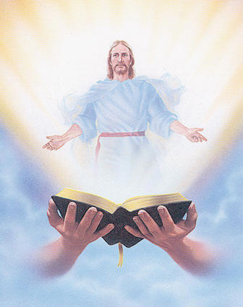
Welcome
Guest

Slide 4
ANNOUNCEMENTS
Feb. 17, 2017

Slide 5
March 2017 MAGNIFICAT ISSUE
is available for
distribution tonight
at the Auditorium.

Slide 6
TEACHINGS
Shepherd's Training - LSS 1- 45
Basic Bible Seminar - LSS 1- 46B
Christian Parenting - LSS 1-47
Sat., Feb. 18, 2017, 1- 6 pm
@ DMP Classrooms

Slide 7
Health & Wellness
Awareness day
Every first Friday at DMP
auditorium during fellowship.
Notes:
Free medical consultations, blood pressure and blood sugar screenings and health tips to be provided by volunteer medical professionals Every First Friday.
Begins on Friday, February 3, 2017

Slide 8
Life in the Spirit
Seminar #47
March 31-April 2, 2017
Salubungan / Acquaintance – Mar 3
Registration is Now Open
Contacts:
Manny & Nette Manguiat – elexman@hotmail.com,
Earl & Flo Manguiat - bldnewarklsa@gmail.com

Slide 9
Marshaling
Schedule
Feb. 24, 2017
Pastoral
Apostolate

Slide 10
ORDERS
“You shall love your neighbor as yourself.”
(Lv 19:8b)
“Love your enemies and pray for those who persecute you”.
(Mt 5:44)

Slide 11
DIRECTIONS
● Be slow to anger and
abound in kindness
always.
● Forgive and make
amends.

