Slide 1
ANNOUNCEMENTS
Feb. 23, 2018

Slide 2
God’s Promise for the week
“I will bless you abundantly…because you obeyed my command.”
(Gn 22:17a, 18b)
Notes:
2

Slide 3
Welcome
Guest

Slide 4
ME45 Ministry Assignment
Paul Martinez – Youth Ministry
Pinky Martinez – Youth Ministry
Rey Pineda – Mission Ministry / Secondary:
Intercessory Ministry
Elma Pineda - Mission Ministry / Secondary:
Intercessory Ministry
Pros Villarica - Intercessory Ministry/Secondary:
Mission Ministry
Minda Villarica - Intercessory Ministry/Secondary:
Mission Ministry

Slide 5
ME45 Ministry Assignment
Arnel Torres – John 6 Ministry
Maribel Torres – John 6 Ministry
York Miguel - Secretariat Ministry
Denise Miguel – Secretariat Ministry
Vince McKenzie – Word Ministry
Paule McKenzie – Word Ministry
Tony Escoto -Intercessory Ministry /
Secondary: Liturgical Ministry
Fe Escoto - Intercessory Ministry / Secondary:
Liturgical Ministry

Slide 6
ME45 Ministry Assignment
Nestor Clarin – Treasury Ministry
Ine Clarin – Treasury Ministry
Carlos Austria – John 6 Ministry
Donna Austria – John 6 Ministry

Slide 7
Save the Date
Disciples’
Assembly
Sat., March 10, 2018

Slide 8
Save the Date
Apr. 7, 2018
Emergence

Slide 9
Life in the
Spirit
Seminar #49
April 13-15, 2018
Salubungan is on March 2, 2018
Contacts: Earl & Flo Manguiat
BLD Newark
Notes:
Applications are currently being accepted

Slide 10
Marshaling
Schedule
March 2, 2018
Formation
Apostolate

Slide 11
ORDER
“Listen to Him.”
(Mk 9:7b)

Slide 12
DIRECTIONS
● Regularly attend mass and
read the scriptures daily.
● Participate in the
community Word Sharing
circles.

Slide 13
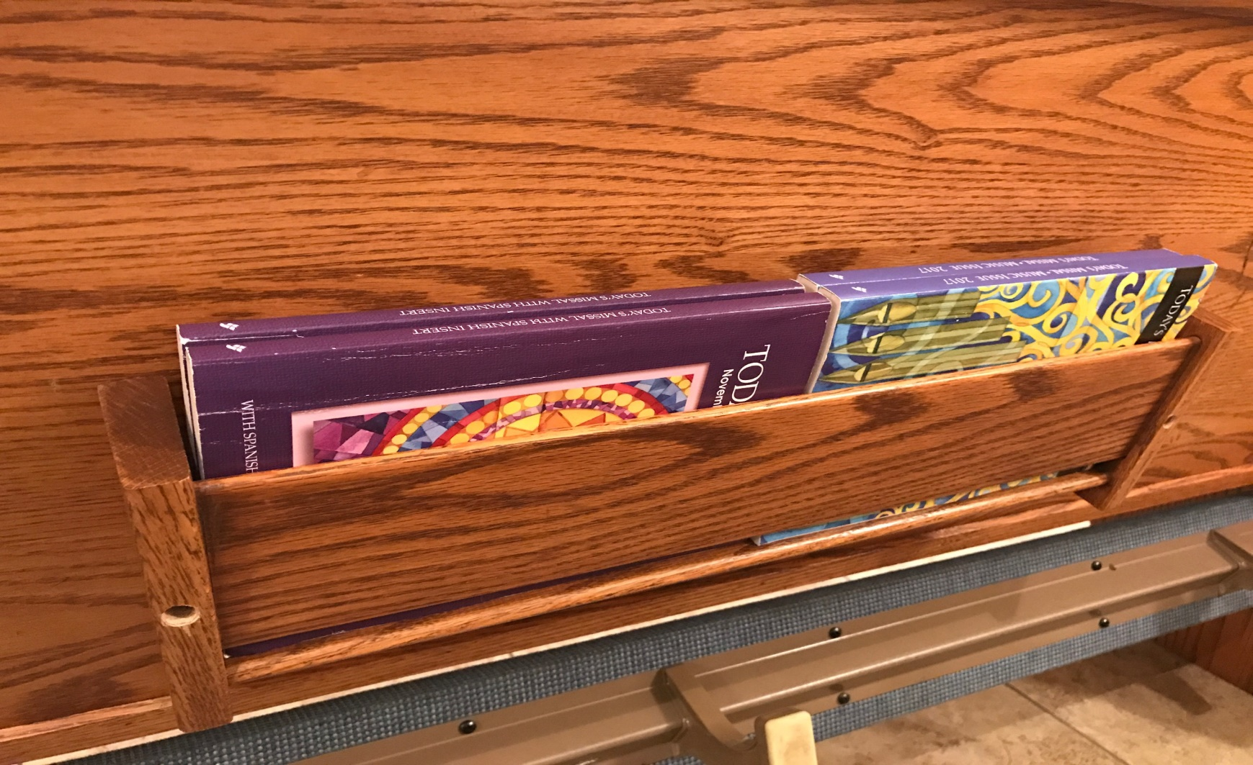
Reminder…
Please help keep the
missalette and song books
in proper order.

