Slide 2
God’s Promise for the week
“Come after me, and
I will make you
fishers of men.”
(Mt 4:19)
Notes:
2

Slide 3
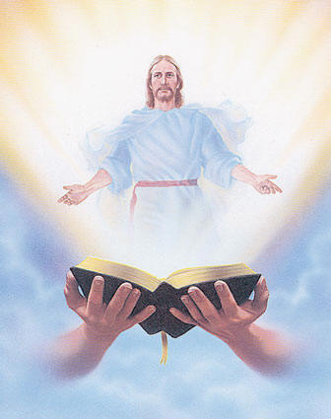
Welcome
Guest

Slide 4
ANNOUNCEMENTS
Jan. 20, 2016

Slide 5
TEACHINGS
Christian Maturity Program II,
Part II - LSS 1- 45
New Creation Realities /
Growth in Prayer - LSS 1- 46B
Sat., Jan. 21, 2017, 1- 6 pm
@ DMP Classrooms

Slide 6
Washington, DC
Contacts:
Nong Bustos / Rey Salmo
Notes:
Rey Salmo

Slide 7
Health & Wellness
Awareness day
Every first Friday at DMP
auditorium during fellowship.
Notes:
Notes:
Starts on February 3
We need licensed medical doctors who can volunteer every First Friday

Slide 8
Marshaling
Schedule
Jan. 27, 2017
Evangelization
Apostolate

Slide 9
ORDER
● Repent, for the Kingdom
of heaven is at hand.
● Be united in the same
mind and in the same
purpose.

Slide 10
DIRECTIONS
● Make a good confession
and reconcile with your
brethren.
● Joyfully accept ministry
assignments as blessings.

