Slide 2
God’s Promise for the week
“Rejoice and be glad, for your reward will be great in heaven.”
(Mt 5:12)
Notes:
2

Slide 3
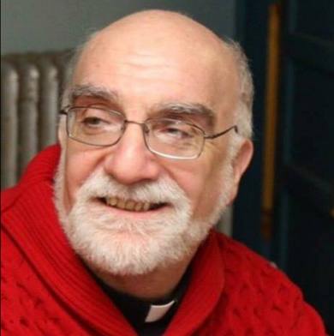
WELCOME
Msgr. Paul Schetelick

Slide 4
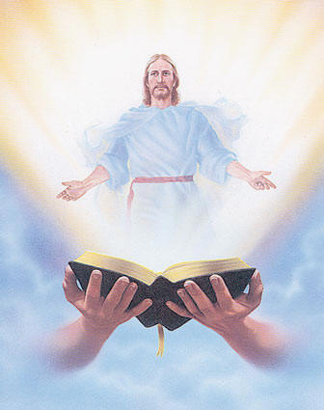
Welcome
Guest

Slide 5
ANNOUNCEMENTS
Jan. 27, 2017

Slide 6
Health & Wellness
Awareness day
Every first Friday at DMP
auditorium during fellowship.
Notes:
Free medical consultations, blood pressure and blood sugar screenings and health tips to be provided by volunteer medical professionals Every First Friday.
Begins on Friday, February 3, 2017

Slide 7
Life in the Spirit
Seminar #47
April 7 - 9, 2017
Salubungan / Acquaintance – Mar 3
Registration is Now Open
Contacts:
Manny & Nette Manguiat – elexman@hotmail.com,
Earl & Flo Manguiat - bldnewarklsa@gmail.com

Slide 8
Marshaling
Schedule
Feb. 3, 2017
Formation
Apostolate

Slide 9
ORDER
Seek the Lord, all you humble of the earth.

Slide 10
DIRECTIONS
● Witness to the virtues of
humility and obedience
● Be meek, merciful and
clean of heart.

