Slide 2
God’s Promise for the week
“I will make you a light to the nations.”
(Is 49:6b)
Notes:
2

Slide 3
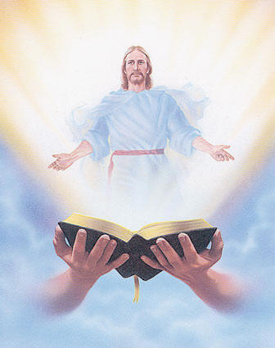
Welcome
Guest

Slide 4
ANNOUNCEMENTS
Jan. 13, 2016

Slide 5
February 2017 MAGNIFICAT ISSUE
is available for
distribution tonight
at the Auditorium.

Slide 6
TEACHINGS
Christian Maturity Program II,
Part II - LSS 1- 45
New Creation Realities /
Growth in Prayer - LSS 1- 46B
Sat., Jan. 21, 2017, 1- 6 pm
@ DMP Classrooms

Slide 7
Washington, DC

Slide 8
Marshaling
Schedule
Jan. 20, 2017
Pastoral
Apostolate

Slide 9
ORDER
● Call upon the name
of our Lord, Jesus
Christ.
● Behold the Lamb of
God!.

Slide 10
DIRECTIONS
● Worship and adore Jesus
in the Eucharist.
● Evangelize and actively
share your faith with
others.

