Slide 1
ANNOUNCEMENTS
Jan. 26, 2018

Slide 2
God’s Promise for the week
“I will raise up for them a prophet…and will put my words into his mouth; he shall tell them all that I command him.”
(Dt 18:18)
Notes:
2

Slide 3
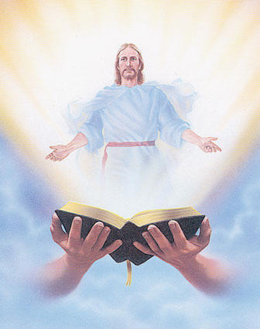
Welcome
Guest

Slide 4
Save the Date
Apr. 7, 2018
Emergence

Slide 5
Marshaling
Schedule
Feb. 2, 2018
Management
Apostolate

Slide 6
ORDER
“...Speak in my Name.”
(Dt 18:19)

Slide 7
DIRECTIONS
● Study God’s Word that you
may be able to proclaim the
Gospel with authority.
● Invoke the name of Jesus
when engaging in spiritual
warfare.

