Slide 2
God’s Promise for the week
“… He shall rescue the poor when he
cries out.”
(Ps 72:12a)
Notes:
2

Slide 3
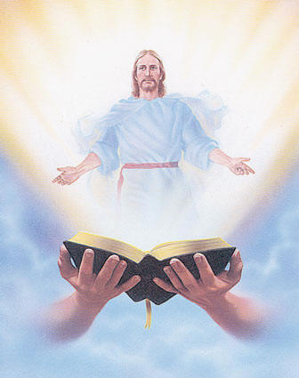
Welcome
Guest

Slide 4
ANNOUNCEMENTS
Jan. 6, 2016

Slide 5
TEACHINGS
Christian Maturity Program II,
Part II - LSS 1- 45
New Creation Realities / Growth
in Prayer - LSS 1- 46B
Sat., Jan. 21, 2017, 1- 6 pm
@ DMP Classrooms

Slide 6
Washington, DC

Slide 7
Marshaling
Schedule
Jan. 13, 2017
Mission
Apostolate

Slide 8
ORDER
Do Him homage.

Slide 9
DIRECTIONS
● Be faithful in attending
praise and worship
regularly.
● Visit Him in the Blessed
Sacrament.

