Slide 1
God’s Promise for the week
“The righteousness will shine like the sun in the kingdom of their Father.”
(Mt 13:43)
Notes:
1

Slide 2
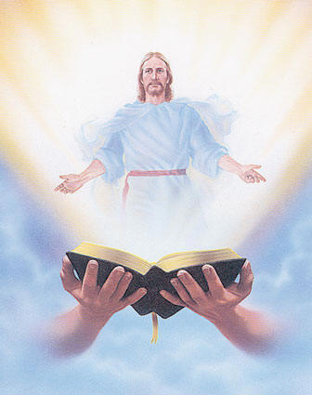
Welcome
Guest

Slide 3
ANNOUNCEMENTS
July 21, 2017

Slide 4
Save the Date!
Disciples Assembly
"We Walk Hand In Hand"
July 29, 2017, Saturday
1:00 pm to 5:00 pm
DMP Auditorium
Contacts: Lisa and Joven Soriano, Joy and Raul Wong, Tatess and Tony Abad, Fe and Sundee Ikalina, Nellie and Ernest Sun
Notes:
Knowing current BLD trends and issues and how the community and its leadership move to worship and serve God.

Slide 5
Reminder…
Please remit payments for all sold tickets and return all unsold tickets to the Dinner Dance Committee after worship tonight.

Slide 6
August 19, 2017
Community Celebration at the
Divine Mercy Parish
August 20, 2017
25th Anniversary Dinner Dance

Slide 7
Marshaling
Schedule
JULY 28, 2017
Evangelization
Apostolate

Slide 8
ORDER
“Pray as we ought... intercede for the holy ones according to
God’s will.”
(Rom 8: 26-27)

Slide 9
DIRECTION
Pray for the intentions of the church and the needs of others.

