Slide 1
God’s Promise for the week
“All things work for good for those who love God,
who are called according
to his purpose.”
(Rom 8:28)
Notes:
1

Slide 2
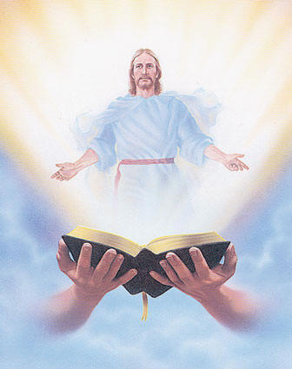
Welcome
Guest

Slide 3
ANNOUNCEMENTS
July 28, 2017

Slide 4
Disciples Assembly
"We Walk Hand In Hand"
Canceled
July 29, 2017, Saturday
1:00 pm to 5:00 pm
DMP Auditorium
Contacts: Lisa and Joven Soriano, Joy and Raul Wong, Tatess and Tony Abad, Fe and Sundee Ikalina, Nellie and Ernest Sun

Slide 5
August 19, 2017
Community Celebration at the
Divine Mercy Parish
August 20, 2017
25th Anniversary Dinner Dance
Notes:
Please Read:
1) If you haven’t done so yet, but are planning to attend,
please send in your RSVP for the Community Celebration.
(2) Regarding the 25th Anniversary Dinner Dance on Aug 20, please turn in ticket remittances to the members of the sponsoring class, ME 40, as soon as possible.
They will have a table set up for this at fellowship.

Slide 6
Marshaling
Schedule
AUG 4, 2017
Formation
Apostolate

Slide 7
ORDER
“Ask something of me
and I will give it to you.”
(1Kgs 3:5)

Slide 8
DIRECTIONS
Seek and know Christ, the
one true treasure, through
daily scripture readings
and prayers.
Regularly share your earthly treasures to the church and community.

