Slide 2
God’s Promise for the week
“Whose sins you forgive are forgiven them.”
​ (Jn 20:23a)
Notes:
2

Slide 3
Welcome
Guest

Slide 4
ANNOUNCEMENTS
June 2, 2017

Slide 5
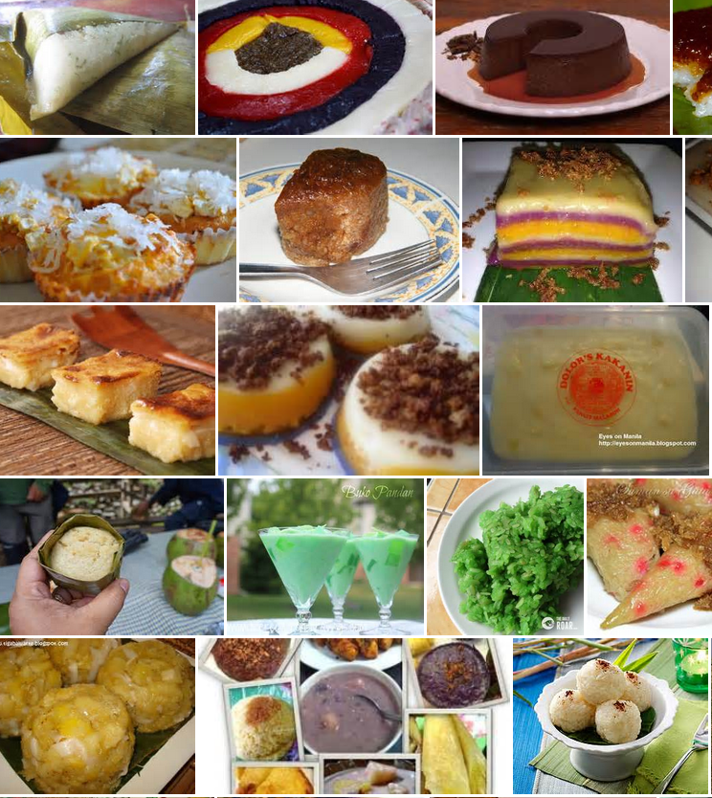
Singles Ministry Bake Sale!
Baked goods, kakanin & native delicacies, gulaman at sago, atbp.
Tonight, June 2
Please help SE# 37

Slide 6
SINGLES
ENCOUNTER #37
June 16-18, 2017
Graymoor Spiritual Life Center
Garrison, NY 10524
Contacts:
Jutt Bustos – jutt.bustos@bldnewark.com
Lita Alfaro – lita.alfaro@bldnewark.com

Slide 7
Solo Parents Encounter
Weekend #19
June 23-25, 2017
DAYS Hotel Conference Center East Brunswick
195 Route 18 South, East Brunswick, NJ
Contacts: Cherry & Rueben Vibar
(SPE18 CS)

Slide 8
YOUTH
ENCOUNTER #24
“Come and Follow Me…”
July 7-9, 2017
Fellowship Deaconry
3575 Valley Road
Basking Ridge
Contact: dyc@bldnewark.com
BLD Newark

Slide 9
FAMILY
ENCOUNTER 24
July 14 - 16, 2017
Malvern Retreat House
Malvern PA
Submit Completed Applications to:
Willy & Amor Ferrer (908) 416-5983
Noel & Gale Deleon (201)320-5194
As for me and my household, we will serve the Lord: Joshua 24:15

Slide 10
August 19, 2017
Community Celebration at the
Divine Mercy Parish
August 20, 2017
25th Anniversary Dinner Dance

Slide 11
Marshaling
Schedule
JUNE 9, 2017
Mission
Apostolate

Slide 12
ORDER
“As the Father
has sent me,
so I send you.”
(Jn 20:21b)

Slide 13
DIRECTION
Use your God-given gifts to Serve His people and contribute to the works of His Kingdom.

