Slide 2

God’s Promise for the week
“I will make of you
a great nation, and
I will bless you.”
(Gn 12:2)
Notes:
2

Slide 3

Welcome
Guest

Slide 4
ANNOUNCEMENTS
Mar. 10, 2017

Slide 5
TEACHINGS
Apologetics - LSS 1- 43
    Prayer Leadership - LSS 1- 45
    Encounter with Jesus - LSS 1-46B
Sat., Mar. 11, 2017, 1- 6 pm
@ DMP Classrooms

Slide 6
To register online, visit:
www.rcan.org/womenscommission

Slide 7


Life in the Spirit
Seminar #47
March 31-April 2, 2017
Contacts:
Manny & Nette Manguiat – elexman@hotmail.com,
Earl & Flo Manguiat - bldnewarklsa@gmail.com

Slide 8
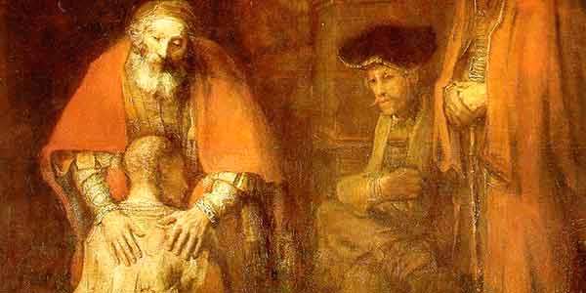
(The Parable of the Prodigal Son)
Join us!
Retreat: Feel the Father’s Love
Msgr. Paul Schetelick
leading the community in
reflection and meditation
Divine Mercy Auditorium
Sat., April 22, 2017, 11:30–6:30 pm

Slide 9


Slide 10
Marshaling
Schedule
Mar. 17, 2017
Management
Apostolate

Slide 11
ORDER
Rise up and do
not be afraid.

Slide 12
DIRECTION
Trust that the Lord will equip you when He calls you to serve in ministry.

