Slide 2
God’s Promise for the week
“Christ will give
you light.”
(Eph 5:14b)
Notes:
2

Slide 3
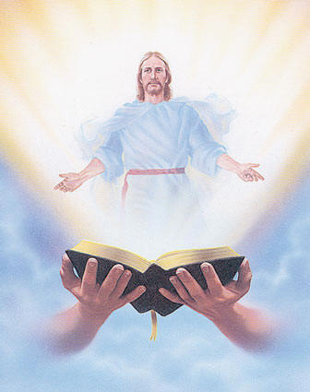
Welcome
Guest

Slide 4
ANNOUNCEMENTS
Mar. 17, 2017

Slide 5
Life in the Spirit
Seminar #47
March 31-April 2, 2017
Contacts:
Manny & Nette Manguiat – elexman@hotmail.com,
Earl & Flo Manguiat - bldnewarklsa@gmail.com

Slide 6
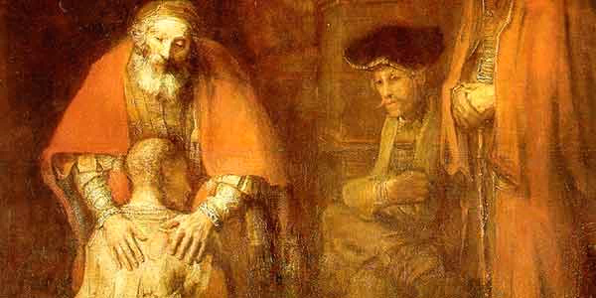
(The Parable of the Prodigal Son)
Join us!
Retreat: Feel the Father’s Love
Msgr. Paul Schetelick
leading the community in
reflection and meditation
Divine Mercy Auditorium
Sat., April 22, 2017, 11:30–6:30 pm

Slide 8
Marshaling
Schedule
Mar. 24, 2017
Mission
Apostolate

Slide 9
ORDER
Worship God in spirit and in truth
(Jn 4:24)

Slide 10
DIRECTIONS
● Pray constantly and read and
reflect on the Word of God
daily.
● Initiate reconciliation with a
brethren and receive the
Sacrament of Reconciliation
frequently.

Slide 11
DIRECTIONS
● Attend Friday worship and
Eucharistic Celebration
regularly.
● Share the victory of Christ in
your life.

