Slide 1
ANNOUNCEMENTS
March 2, 2018

Slide 2
God’s Promise for the week
“The law of the Lord is perfect, refreshing the soul…giving wisdom
to the simple.”
(Ps 19:8a)
Notes:
2

Slide 3
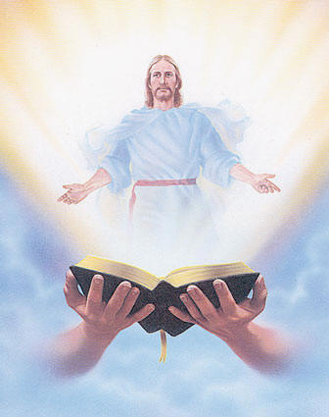
Welcome
Guest

Slide 4
Save the Date
Disciples’
Assembly
Sat., March 10, 2018

Slide 5
Save the Date
Apr. 7, 2018
Emergence

Slide 6
Life in the
Spirit
Seminar #49
April 13-15, 2018
Salubungan is on March 2, 2018
Contacts: Earl & Flo Manguiat
BLD Newark
Notes:
Applications are currently being accepted

Slide 7
Marshaling
Schedule
March 9, 2018
Management
Apostolate

Slide 8
ORDER
“…love me and
keep my commandments.”
(Ex 20:6b)

Slide 9
DIRECTION
Read, meditate, and share the word of God during the Lenten season.

Slide 10
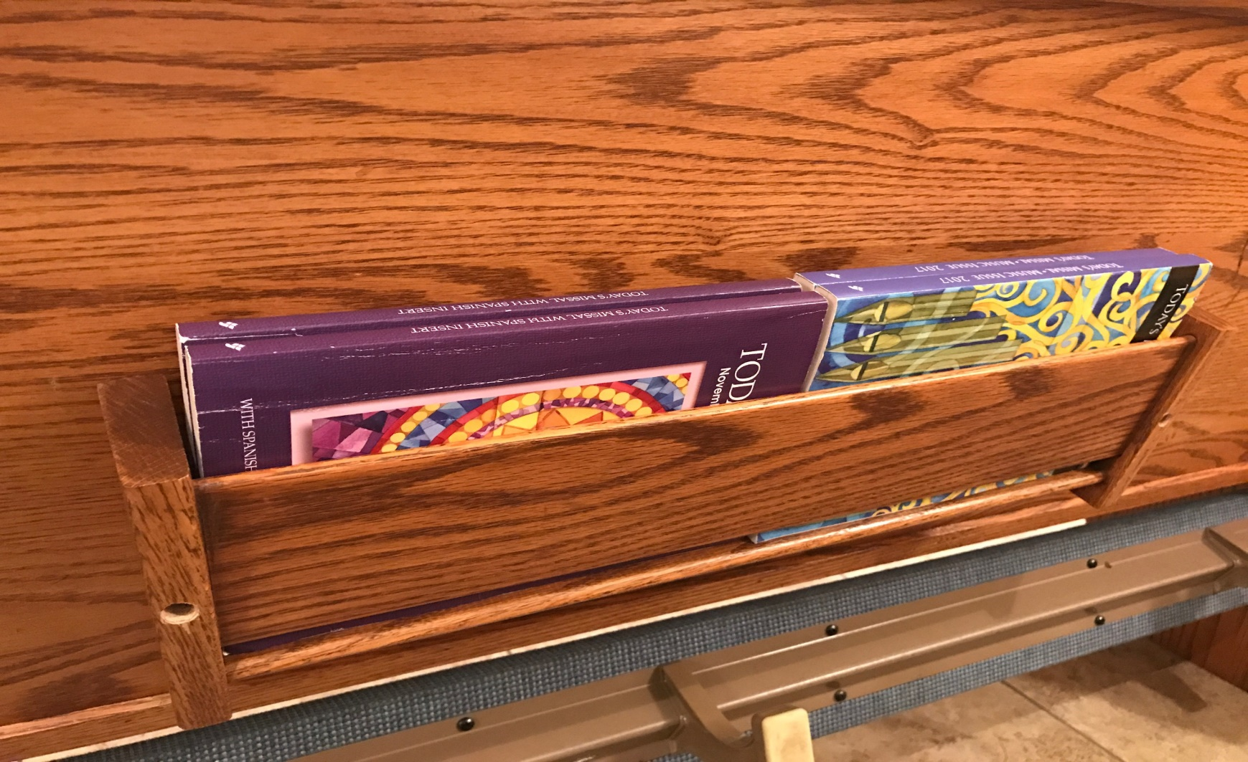
Reminder…
Please help keep the
missalette and song books
in proper order.

