Slide 2

God’s Promise for the week
“… through the obedience of the one, the many will be made righteous.”
(Rom 5:19b)
Notes:
2

Slide 3

Welcome
Guest

Slide 4
ANNOUNCEMENTS
Mar. 3, 2017

Slide 5


Health & Wellness
Awareness day
Every first Friday at DMP
auditorium during fellowship.
Notes:
Free medical consultations, blood pressure and blood sugar screenings and health tips to be provided by volunteer medical professionals Every First Friday.
Begins on Friday, February 3, 2017

Slide 6
TEACHINGS
Apologetics - LSS 1- 43
    Prayer Leadership - LSS 1- 45
    Encounter with Jesus - LSS 1-46B
Sat., Mar. 11, 2017, 1- 6 pm
@ DMP Classrooms

Slide 7
Notes:
Register online at
www.NJCatholicMen.org

Slide 8
To register online, visit:
www.rcan.org/womenscommission

Slide 9


Life in the Spirit
Seminar #47
March 31-April 2, 2017
Contacts:
Manny & Nette Manguiat – elexman@hotmail.com,
Earl & Flo Manguiat - bldnewarklsa@gmail.com

Slide 10
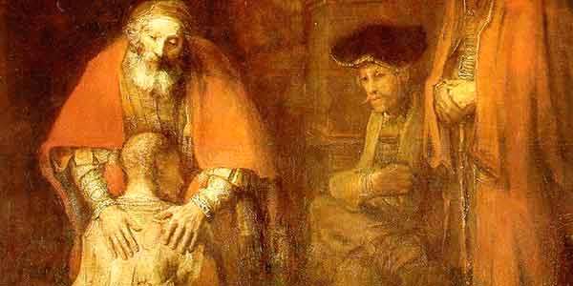
Prodigal Son Retreat
Join us!
Msgr. Paul Schetelick
leading the community in
reflection and meditation
Divine Mercy Auditorium
Sat., April 22, 2017, 12:30–6 pm

Slide 11


Slide 12
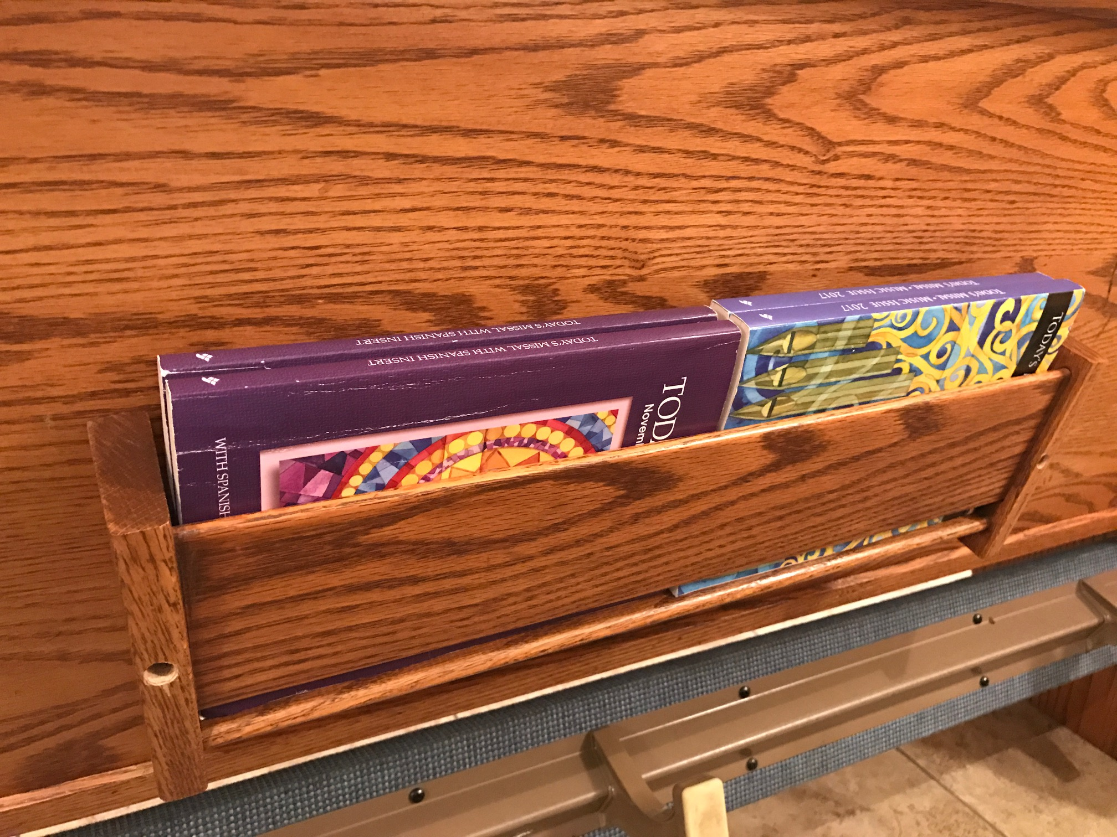
Just a Reminder…
Please return the
books accordingly.

Slide 13
Marshaling
Schedule
Mar. 10, 2017
Formation
Apostolate

Slide 14
ORDER
“Listen to him.”
(Mt 17:5b)

Slide 15
DIRECTIONS
● Be reconciled with God by
going to confession regularly,
especially during the Lenten
season.
● Deepen your faith through
prayer, fasting and generous
almsgiving.

