Slide 1
ANNOUNCEMENTS
March 9, 2018

Slide 2
God’s Promise for the week
“Whoever believes
in him will not be condemned.”
(Jn 3:18a)
Notes:
2

Slide 3
Welcome
Guest

Slide 4
Save the Date
Disciples’
Assembly
Sat., March 10, 2018
1-6 pm DMP Auditorium

Slide 5
TEACHINGS
Christian Maturity Program II,
Part 1 – LSS 1- 46
Encounter with Jesus: Mark &
Matthew - LSS 1 -48
Sat., Mar. 17, 2018, 1- 6 pm
@ DMP Classroom

Slide 6
Save the Date
Apr. 7, 2018
Emergence

Slide 7
Life in the
Spirit
Seminar #49
April 13-15, 2018
Contacts: Earl & Flo Manguiat
bldnewarklsa@gmail.com
BLD Newark
Notes:
Applications are currently being accepted

Slide 8
Marshaling
Schedule
March 16, 2018
Mission
Apostolate

Slide 9
ORDER
Believe in Him…so that you…might not perish, but have eternal life.
(Jn 3:16 par.)

Slide 10
DIRECTIONS
Know Him, love Him, and serve Him.
Study and live the Word.
Pray unceasingly.

Slide 11
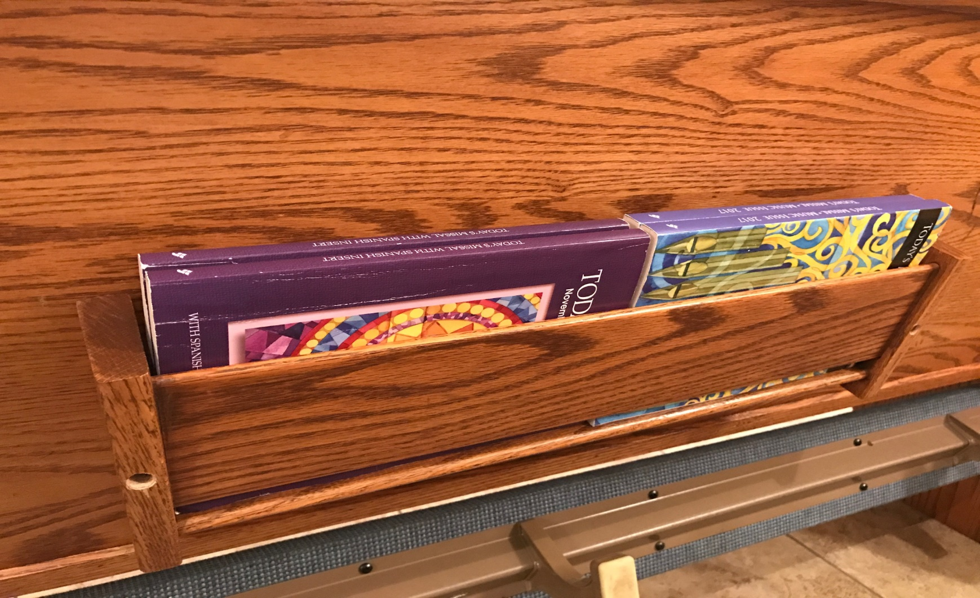
Reminder…
Please help keep the
missalette and song books
in proper order.

