Slide 2
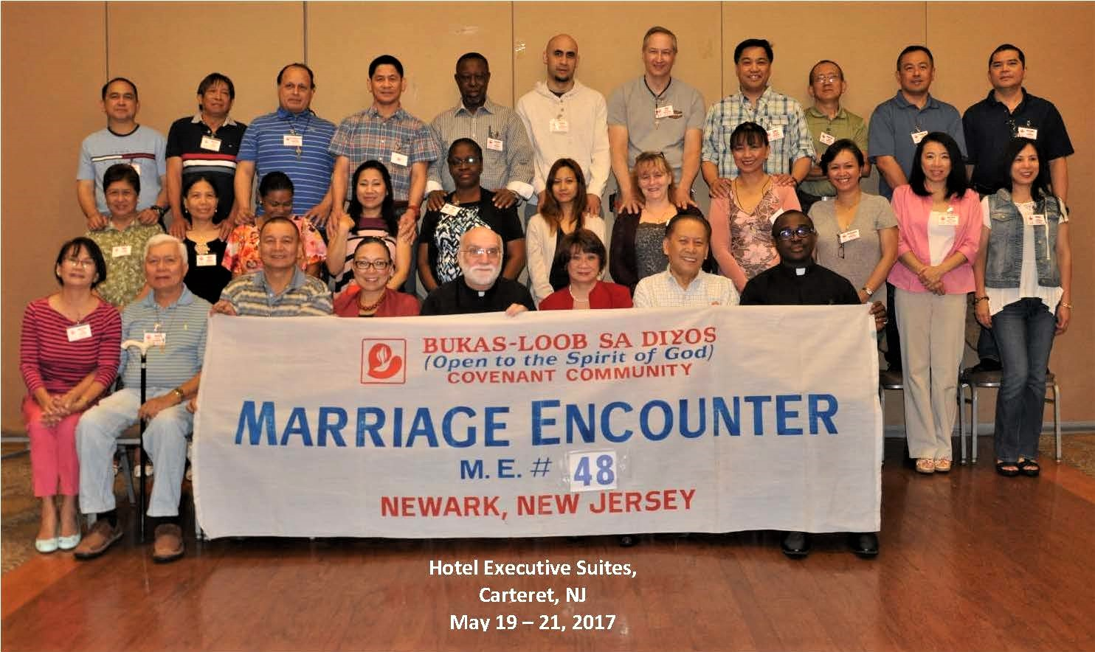
Welcome ME 48

Slide 3
God’s Promise for the week
“I am with you always,
until the end of age.”
​ (Mt 20:20b)
Notes:
3

Slide 4
Welcome
Guest

Slide 5
ANNOUNCEMENTS
May 26, 2017

Slide 6
SINGLES
ENCOUNTER #37
June 16-18, 2017
Graymoor Spiritual Life Center
Garrison, NY 10524
Contacts:
Jutt Bustos – jutt.bustos@bldnewark.com
Lita Alfaro – lita.alfaro@bldnewark.com

Slide 7
Solo Parents Encounter
Weekend #19
June 23-25, 2017
DAYS Hotel Conference Center East Brunswick
195 Route 18 South, East Brunswick, NJ
Contacts: Cherry & Rueben Vibar
(SPE18 CS)

Slide 8
YOUTH
ENCOUNTER #23
“Come and Follow Me…”
July 7-9, 2017
Fellowship Deaconry
3575 Valley Road
Basking Ridge
Contact: dyc@bldnewark.com
BLD Newark

Slide 9
FAMILY
ENCOUNTER 24
July 14 - 16, 2017
Malvern Retreat House
Malvern PA
Submit Completed Applications to:
Willy & Amor Ferrer (908) 416-5983
Noel & Gale Deleon (201)320-5194
As for me and my household, we will serve the Lord: Joshua 24:15

Slide 10
August 19, 2017
Community Celebration at the Basilica
August 20, 2017
25th Anniversary Dinner Dance

Slide 11
From the Dinner Dance committee:
1. ME class shepherds or representative must secure initial
10 tickets from the Dinner dance committee, c/o ME40 at
Fellowship.
2. If ME Classes are sold out on initial 10 tickets distributed,
please see them at fellowship for more. This is on a first
come, first serve basis.

Slide 12
Marshaling
Schedule
JUNE 2, 2017
Management
Apostolate

Slide 13
ORDER
“Go ... teach them to observe all that I have commanded you.”
(Mt 28:19a, 20a)

Slide 14
DIRECTION
Be a good shepherd
to others by word and deed.

