Slide 2
God’s Promise for the week
“… everyone who has more will be given and he will grow rich.”
(Mt 25:29a)
Notes:
2

Slide 3
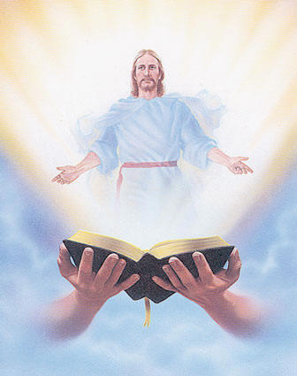
Welcome
Guest

Slide 4
ANNOUNCEMENTS
Nov. 17, 2017

Slide 5
FRIDAY, JANUARY 19, 2018

Slide 6
Marshaling
Schedule
Nov. 24, 2017
Management
Apostolate

Slide 7
ORDER
“Come, share your master’s joy.”
(Mt 25:23c)

Slide 8
DIRECTIONS
Be faithful in small matters,
and you will be entrusted
with great responsibilities.
Use your God-given talent to
evangelize and help others
grow in holiness.

