Slide 2
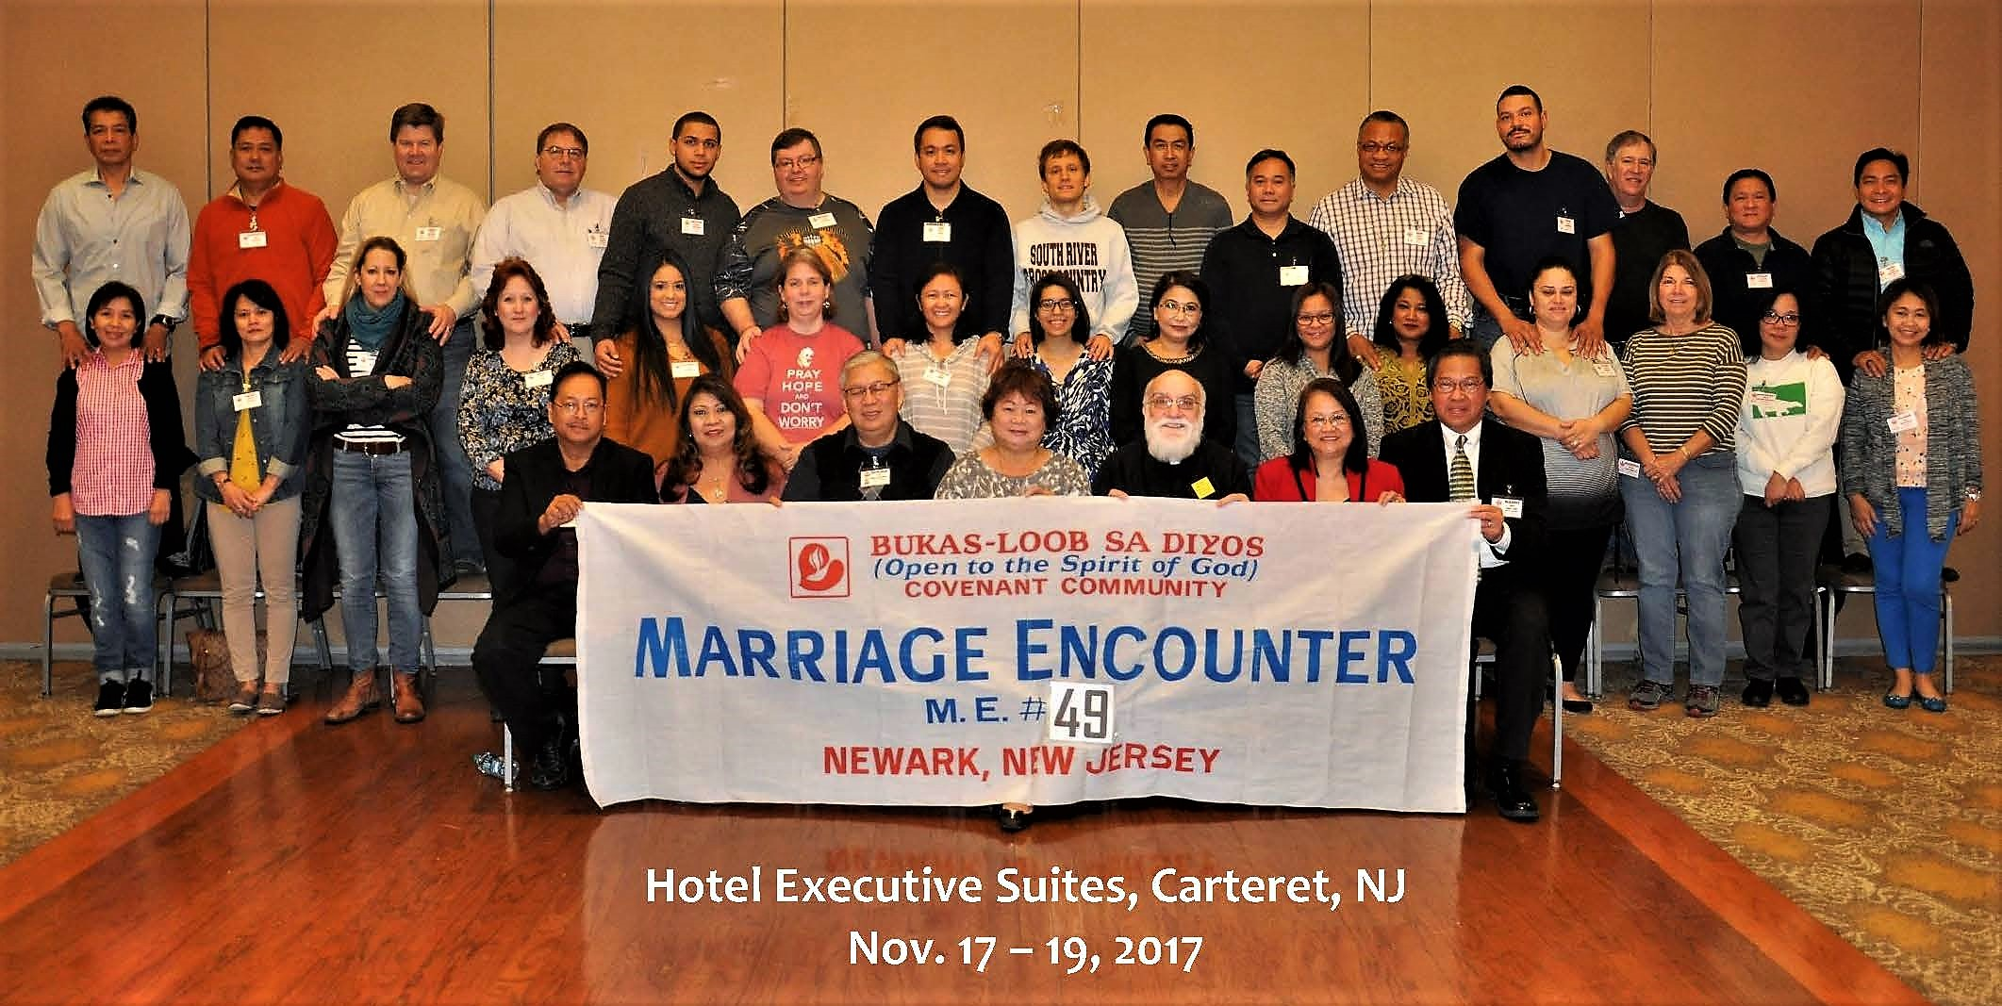
Welcome ME 49

Slide 3
God’s Promise for the week
“The lost I will seek out, the strayed I will bring back, the injured I will bind up, the
sick I will heal.”
(Ez 34:16a)
Notes:
3

Slide 4
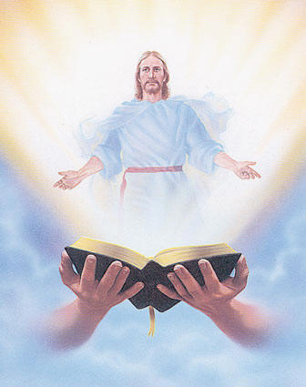
Welcome
Guest

Slide 5
ANNOUNCEMENTS
Nov. 24 2017

Slide 6
Marshaling
Schedule
Dec. 1, 2017
Mission
Apostolate

Slide 7
ORDER
● Look after and tend my
sheep. (Ez 34:11)
● Whatever you do for
one of the least brothers
of mine, you do for me.
(Mt 25:40)

Slide 8
DIRECTIONS
● Do corporal and spiritual
works of mercy.
● Actively participate in the life
and mission of the Church in
accord with our God-given
gifts.

