Slide 2
God’s Promise for the week
“… whoever humbles himself will be exalted.”
(Mt 23:12b)
Notes:
2

Slide 3
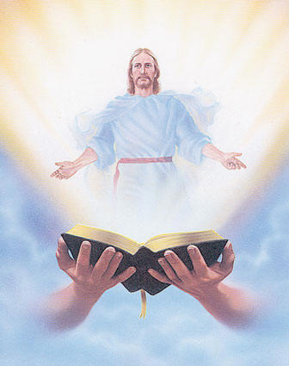
Welcome
Guest

Slide 4
ANNOUNCEMENTS
Nov. 3, 2017

Slide 5
TEACHINGS
Sienna Gifts Inventory - LSS 1- 48
CMP I - Part II - LSS 1- 47
Healing and Deliverance- LSS 1- 46
Sat., Nov. 11, 2017, 1- 6 pm
@ DMP Classroom

Slide 6
Support the
BLD Newark 2017
Fundraiser !!!
Get a chance to win a trip
for 2 to Holy Land!
Raffle date is Friday
November 10, 2017
Notes:
Just $2 a ticket, your friends and family will have a chance to win the top prize of a trip to the Holy Land!
Please READ
*** Please return all tickets sold and unsold at room 102 on Nov 10 before the raffle draw.

Slide 7
What is God’s plan
in our married life?
Join the…
Marriage Encounter
Weekend #49
Nov. 17-19, 2017
Hotel Executive Suite
30 Minue Street
Carteret, NJ 07008
Please email us at mla@bldnewark.com
BLD Newark

Slide 8
FRIDAY, JANUARY 19, 2018

Slide 9
Marshaling
Schedule
Nov. 10, 2017
Evangelization
Apostolate

Slide 10
ORDER
Do not be called Master, you have
but One Master,
the Christ.
(Mt23:10)

Slide 11
DIRECTION
Serve one another in humility.

