Slide 2
God’s Promise for the week
“God will fully supply whatever you need, in accord with his glorious riches in Christ Jesus.”
(Phil 4:19)
Notes:
2

Slide 3
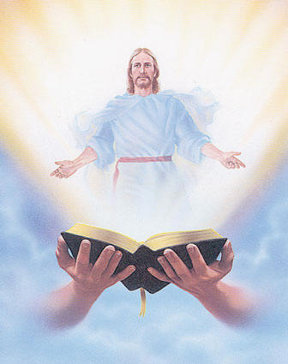
Welcome
Guest

Slide 4
ANNOUNCEMENTS
Oct. 13, 2017

Slide 5
2018 Magnificats Renewal
Deadline: Oct 20, 2017
Please submit orders and payments per Ministry/or M.E. class to Marc / Emma.
Notes:
DEADLINE for submitting orders and payment will be OCTOBER 20, 2017. We apologize but WE WILL NOT ACCEPT ORDERS AFTER THE DEADLINE.
Rate are still the same:
1) English - $20.00/year
2) Spanish - $15.00/year
3) Magnifikids - $12.30/year
4) Large prints (English) - $40.00/year
We would appreciate if everyone will COMPLY with the deadline

Slide 6
TEACHINGS
New Creation Realities /
Growth in Prayer - LSS 1- 48
Gifts and Fruit of the Holy Spirit
- LSS 1- 47
Advanced Intercession -LSS 1- 45
Sat., Oct. 21, 2017, 1- 5 pm
@ DMP Classrooms

Slide 7
MARK 10
Parade of Saints
Friday, October 27, 2017
Divine Mercy Parish
Notes:
Please bring candies and or treats for the children at the fellowship.

Slide 8
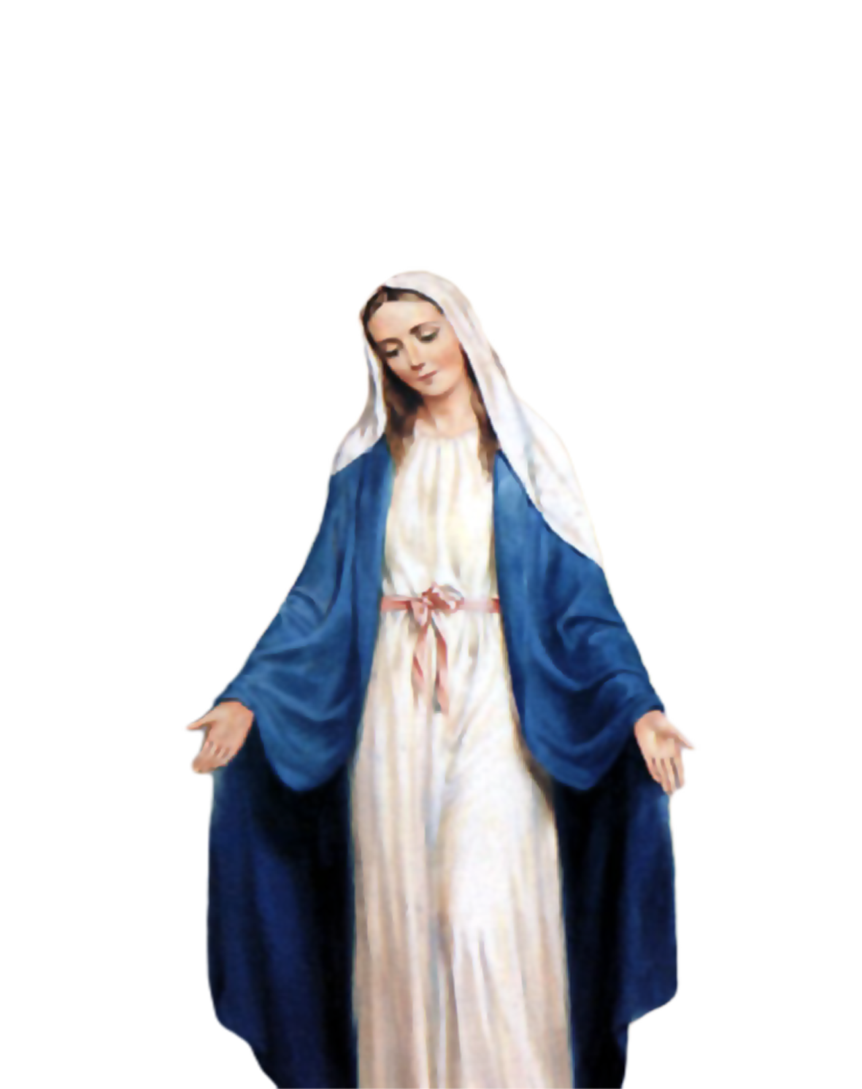
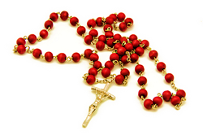
2000 HAIL
MARY
Saturday, October 28
Start - 8:30am
DMP Library

Slide 9
What is God’s plan
in our married life?
Join the…
Marriage Encounter
Weekend #49
Nov. 17-19, 2017
Hotel Executive Suite
30 Minue Street
Carteret, NJ 07008
Please email us at mla@bldnewark.com
BLD Newark

Slide 10
Support the
BLD Newark 2017
Fundraiser !!!
Get a chance to win a trip
for 2 to Holy Land!
Raffle date is Friday
November 10, 2017
Notes:
Just $2 a ticket, your friends and family will have a chance to win the top prize of a trip to the Holy Land!

Slide 11
Marshaling
Schedule
Oct. 20, 2017
Management
Apostolate

Slide 12
ORDER
“Go out, therefore, into the main roads and invite to the feast whomever you find.”
(Mt 22:9)

Slide 13
DIRECTIONS
Bring the LSS to the other parishes.
2. Invite your family and
friends to our encounters
and retreats.

