Slide 2
God’s Promise for the week
“If he cries out to me,
I will hear him; for
I am compassionate.”
(Ex 22:26b)
Notes:
2

Slide 3
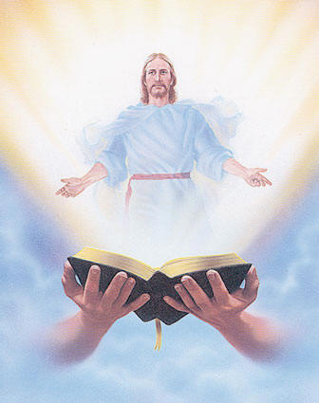
Welcome
Guest

Slide 4
ANNOUNCEMENTS
Oct. 27, 2017

Slide 5
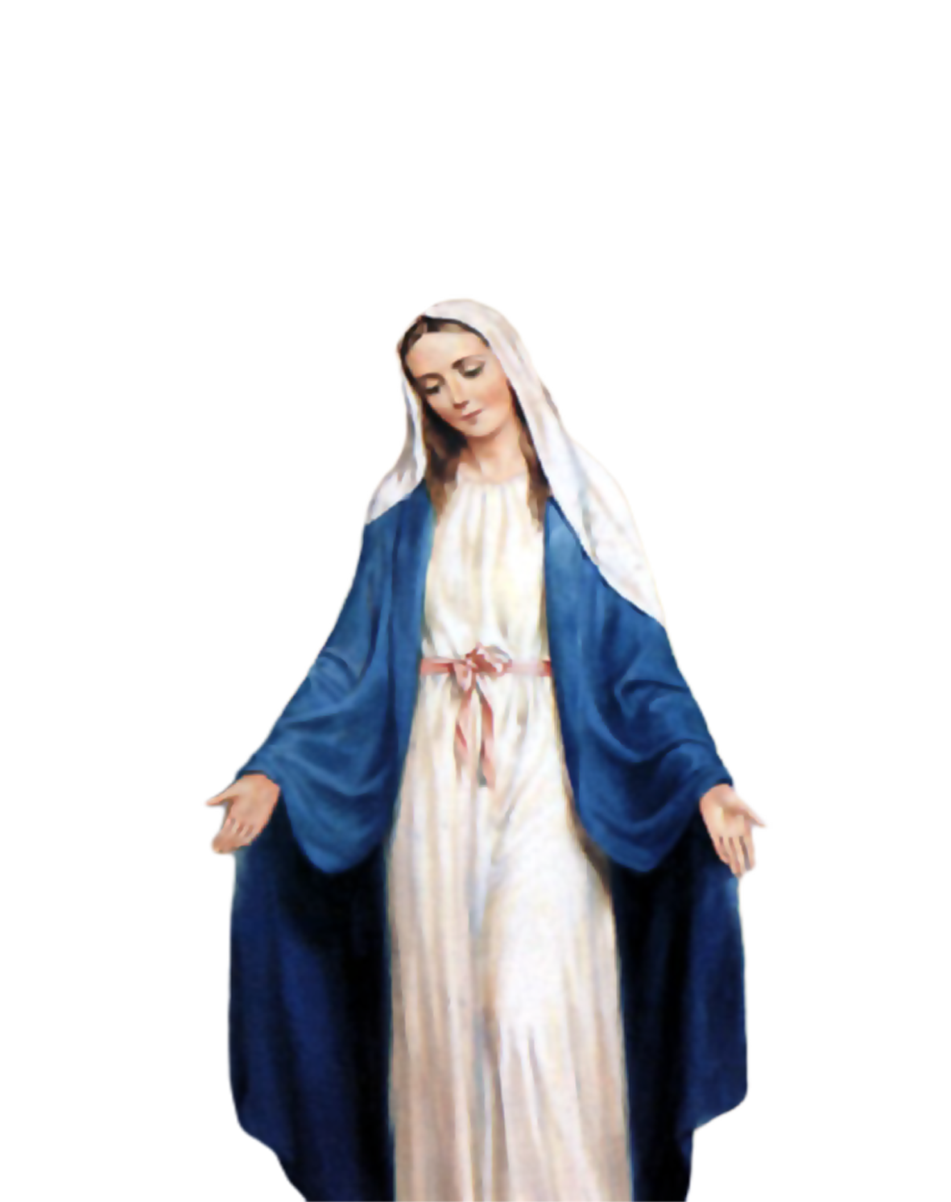
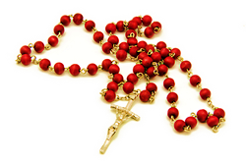
2000 HAIL
MARY
Saturday, October 28
Start - 8:30am
DMP Library

Slide 6
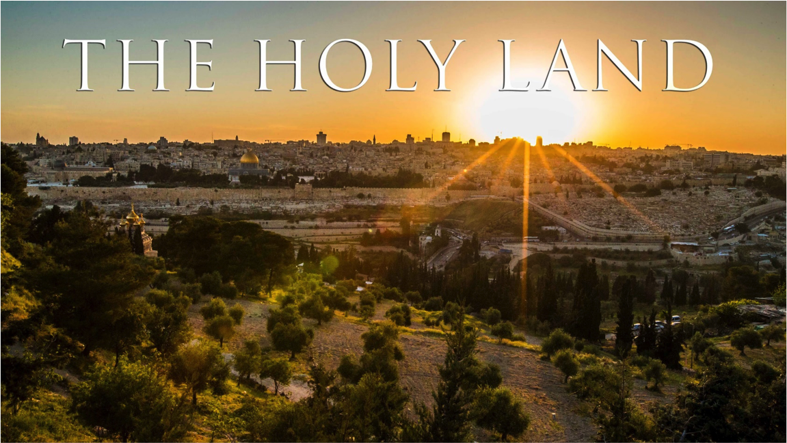
Support the
BLD Newark 2017
Fundraiser !!!
Get a chance to win a trip
for 2 to Holy Land!
Raffle date is Friday
November 10, 2017
Notes:
Just $2 a ticket, your friends and family will have a chance to win the top prize of a trip to the Holy Land!

Slide 7
What is God’s plan
in our married life?
Join the…
Marriage Encounter
Weekend #49
Nov. 17-19, 2017
Hotel Executive Suite
30 Minue Street
Carteret, NJ 07008
Please email us at mla@bldnewark.com
BLD Newark

Slide 8
Marshaling
Schedule
Nov. 3, 2017
Pastoral
Apostolate

Slide 9
ORDER
"You shall love the Lord, your God … you shall love your neighbor as yourself.”
(Mt 22:37;39)

Slide 10
DIRECTIONS
Do corporal and spiritual
works of mercy.
2. Accord your brothers and
sisters respect, fairness and
justice.
3. Uphold human dignity.

