Slide 2
God’s Promise for the week
“Forgive your neighbor
the wrong done to you,
then… your own sins
will be forgiven.”
(Sir 28:2)
Notes:
2

Slide 3
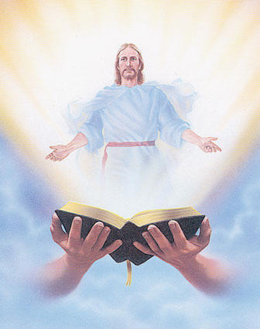
Welcome
Guest

Slide 4
ANNOUNCEMENTS
Sept. 15, 2017

Slide 5
October 2017 MAGNIFICAT ISSUE
is available for
distribution tonight
at the Auditorium.

Slide 6
2018 Magnificats Renewal
Deadline: Oct 20, 2017
Please submit orders and payments per Ministry/or M.E. class to Marc / Emma.
Notes:
DEADLINE for submitting orders and payment will be OCTOBER 20, 2017. We apologize but WE WILL NOT ACCEPT ORDERS AFTER THE DEADLINE.
Rate are still the same:
1) English - $20.00/year
2) Spanish - $15.00/year
3) Magnifikids - $12.30/year
4) Large prints (English) - $40.00/year
We would appreciate if everyone will COMPLY with the deadline

Slide 7
TEACHINGS
Christian Parenting - ME48/SPE19
Christian Maturity Program I
Part I - LSS 1-47
Shepherds Training - LSS 1-45
Sat., Sept. 16, 2017, 1- 5 pm
@ DMP Classroom

Slide 8
John 6
Crossing # 18
October 6 - 8, 2017
Fellowship Deaconry ​Basking Ridge, NJ
Contacts: Tony & Marlene Brillantes
BLD Newark

Slide 9
Life in the
Spirit
Seminar #48
October 13-15, 2017
Divine Mercy Parish, Rahway NJ
Contacts: Earl & Flo Manguiat
BLD Newark

Slide 10
What is God’s plan
in our married life?
Join the…
Marriage Encounter
Weekend #49
Nov. 17-19, 2017
Hotel Executive Suite
30 Minue Street
Carteret, NJ 07008
Please email us at mla@bldnewark.com
BLD Newark

Slide 11
Marshaling
Schedule
Sept. 22, 2017
Mission
Apostolate

Slide 12
ORDER
Forgive your brother from your heart.
(cf Mt 18:35)

Slide 13
DIRECTIONS
Set enmity aside, hate not your neighbor, and overlook faults.
Soften your hearts and be quick to forgive.

